Slide 1
Wireframes
low fidelity
My Thai Star - Devon Example

Slide 2
Index
Invite friends
Create invite for friends
Create reservation
Handle Invite
Revoke accepted invite
Find table by reservation info
Cancel invite
Digital menu
Filter menu
Define order
Order the order
Cancel order
Read Twitter rating for dishes
User profile
User profile
Rate by Twitter
Receive mail to rate your dish
Rate your dish
Waiter Cockpit
See all orders/reservations

Slide 3
Invite friends
MY THAI STAR

Slide 4
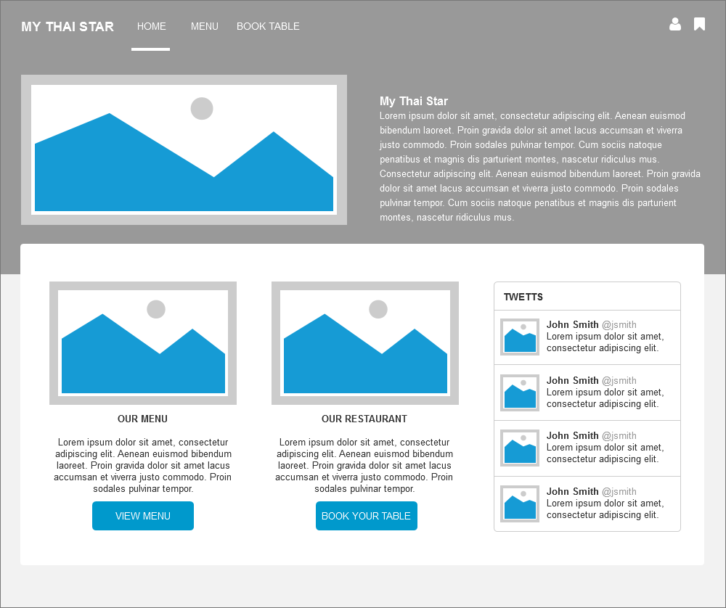
Invite friends: Create invite for friends
HOME UI
Go to book table and invite friends

Slide 5
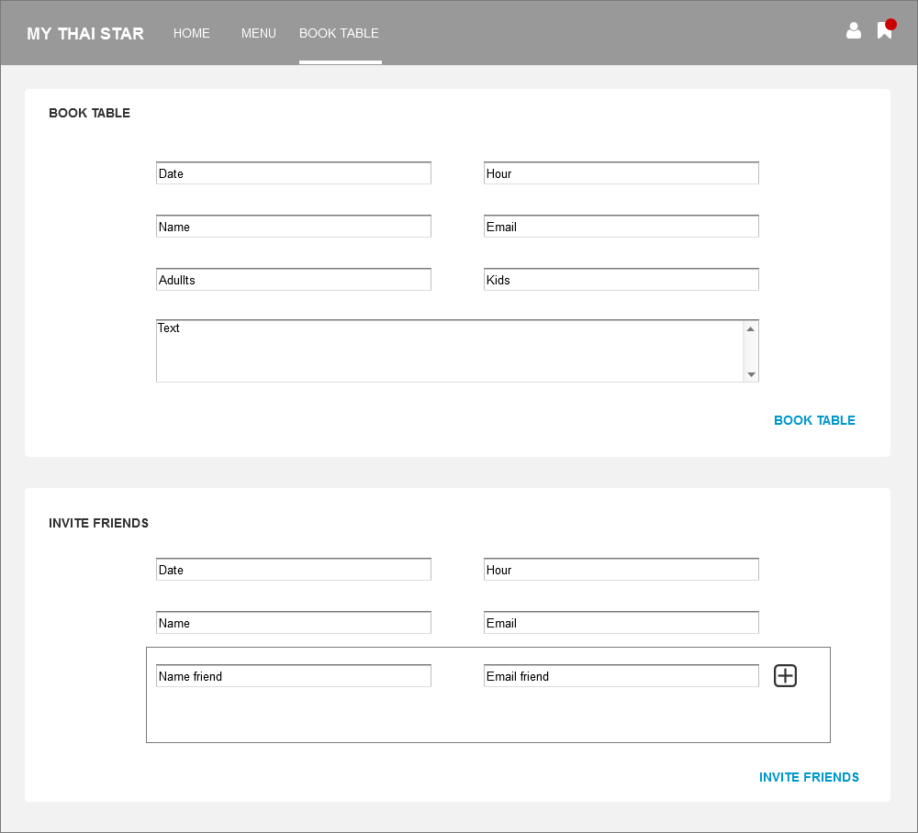
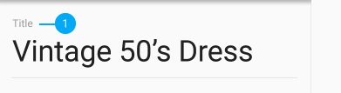
Invite friends: Create invite for friends
BOOK TABLE UI
Invite friends form

Slide 6
Invite friends: Create reservation
BOOK TABLE UI
Book table form

Slide 7
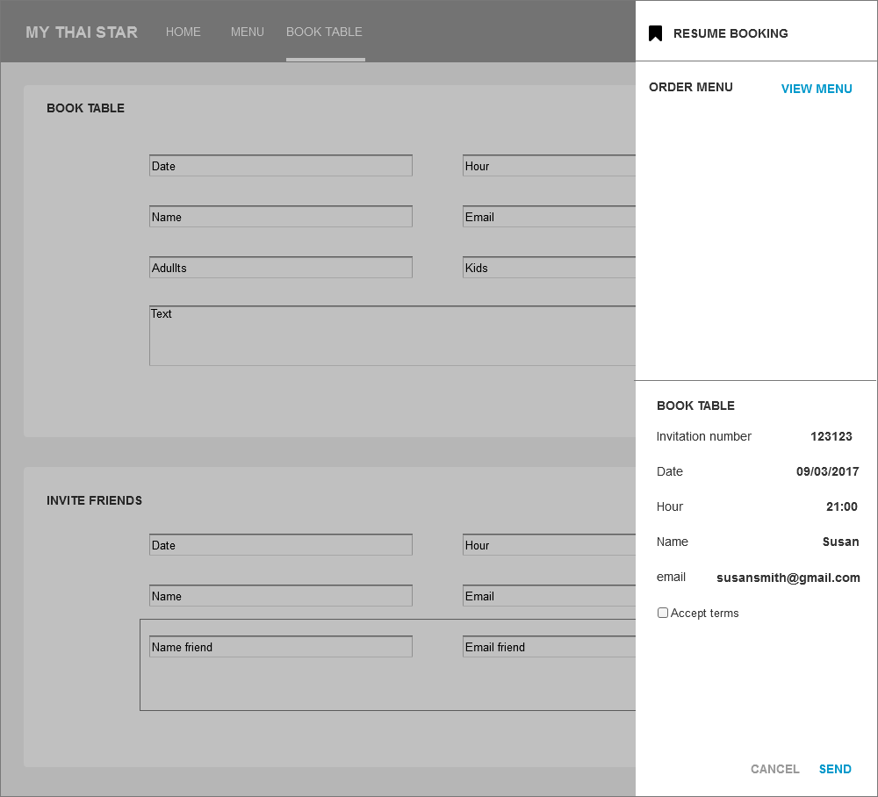
Invite friends: Send invite for friends
BOOK TABLE UI
Invite friends panel.
You can send invitation or add an order to invitation before send it.

Slide 8
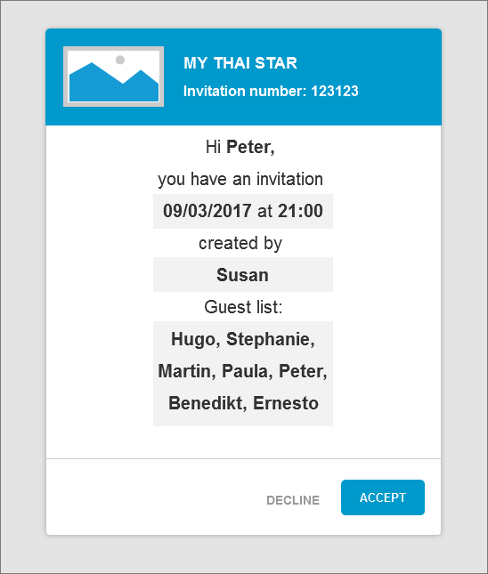
Invite friends: Handle invite
EMAIL NEWSLETTER UI
Email invitation

Slide 9
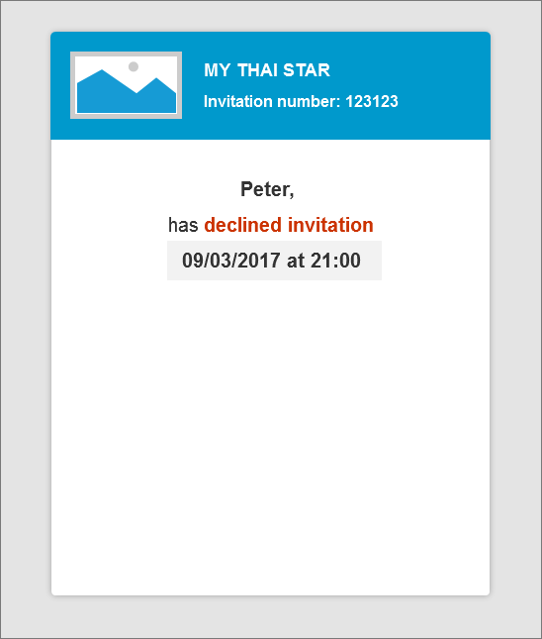
Invite friends: Revoke accepted invite
EMAIL NEWSLETTER UI
Email decline invitation

Slide 10
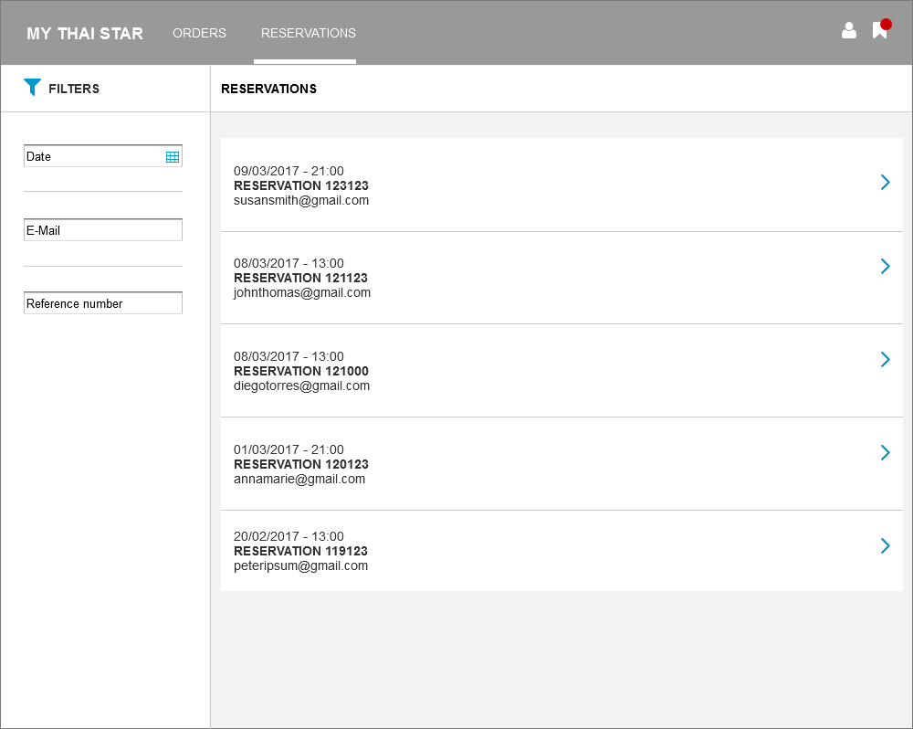
Invite friends: Find table by reservation info
WAITER AREA UI
Reservations list

Slide 11
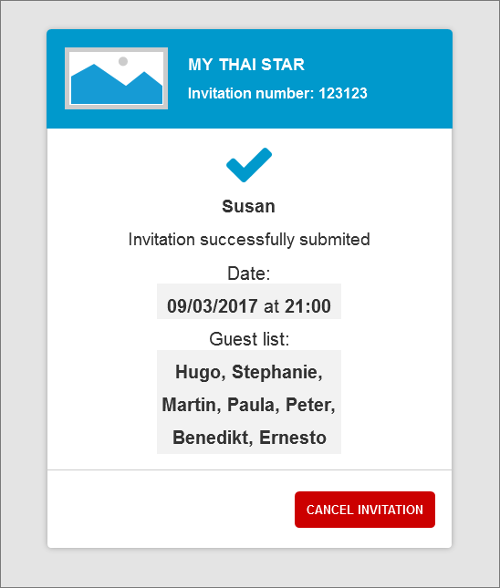
Invite friends: Cancel invite
EMAIL NEWSLETTER UI
Confirmation email with cancel invitation option

Slide 12
Digital menu
MY THAI STAR

Slide 13
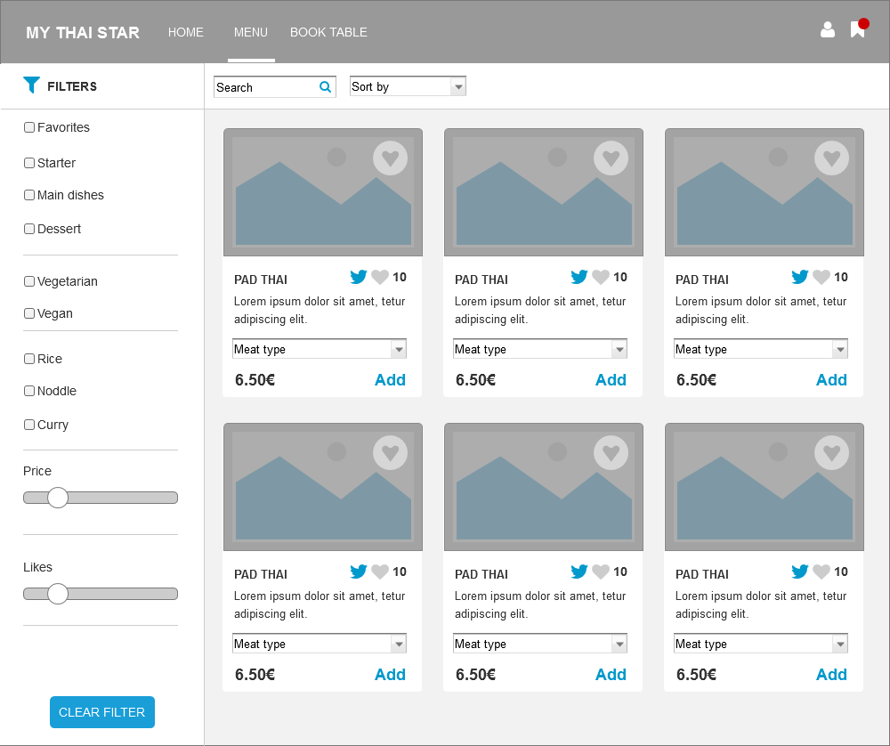
Digital menu: Filter menu
MENU UI
Filters

Slide 14
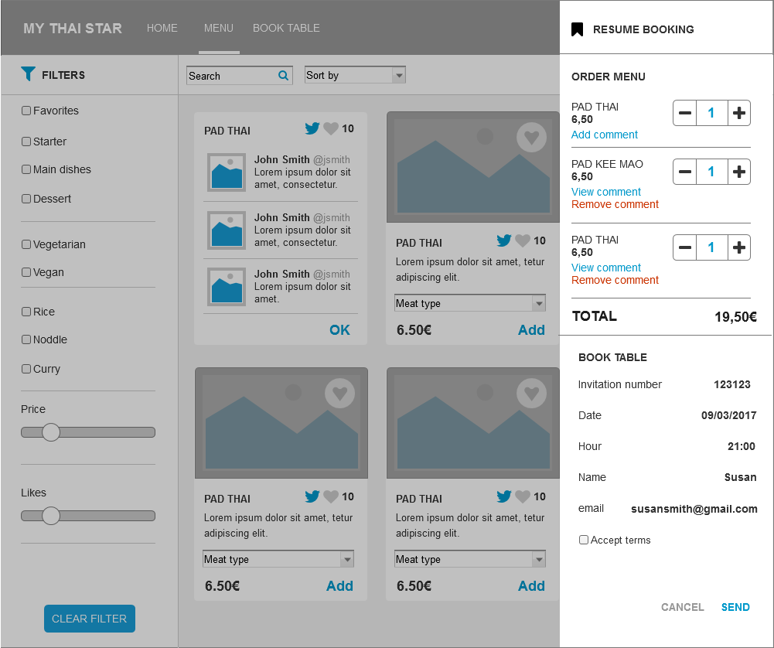
Digital menu: Define order
MENU UI
Select dishes

Slide 15
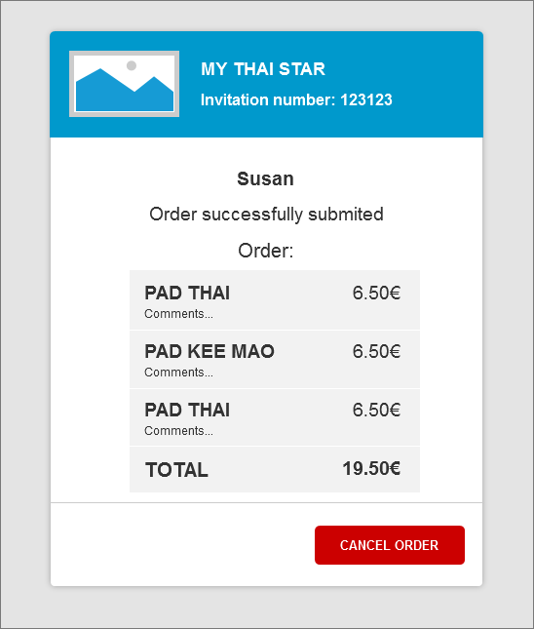
Digital menu: Order the order
MENU UI ORDER THE ORDER
Send order
EMAIL NEWSLETTER UI
Order confirmation

Slide 16
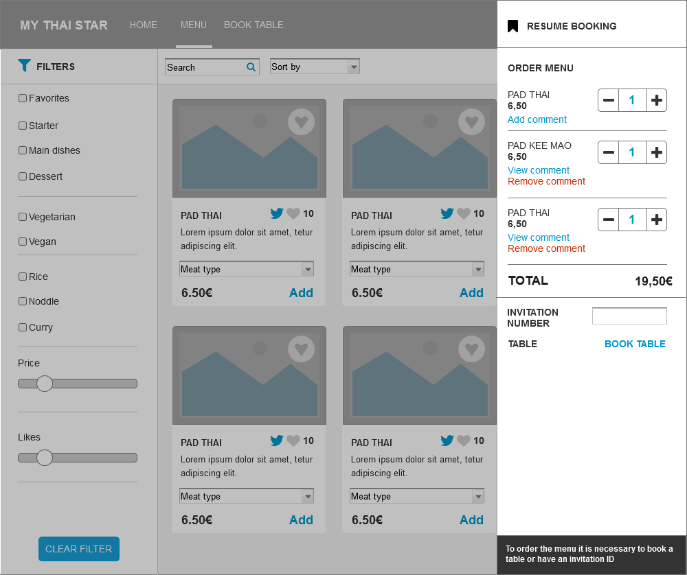
Digital menu: Order the order - precondition for ordering
MENU UI ORDER THE ORDER
precondition for ordering
You need book a table or introduce an invitatio ID to order menu.

Slide 17
Digital menu: Cancel order
EMAIL NEWSLETTER UI
Confirmation email with cancel order

Slide 18
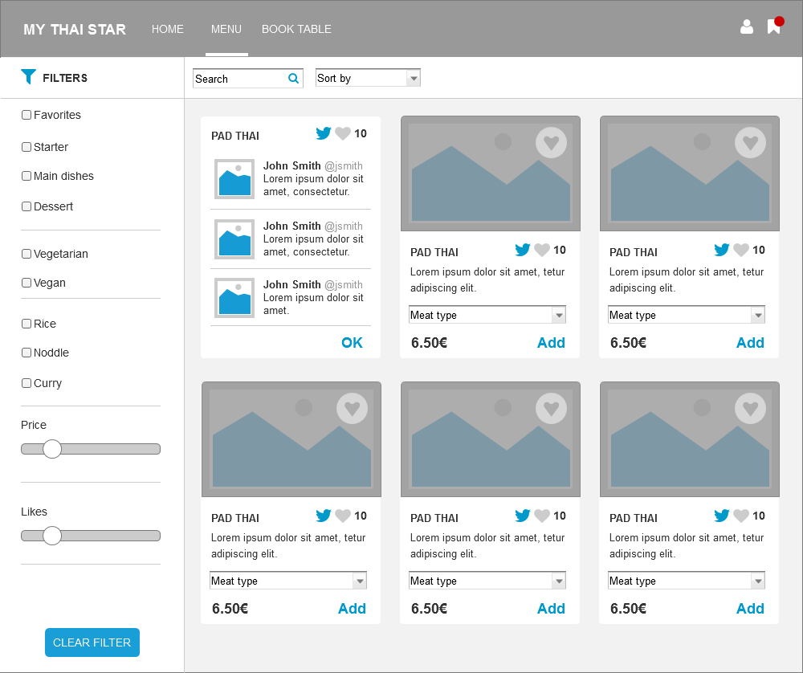
Digital menu: Read Twitter rating for dishes
MENU UI
Twitter rating for dishes

Slide 19
User profile
MY THAI STAR

Slide 20
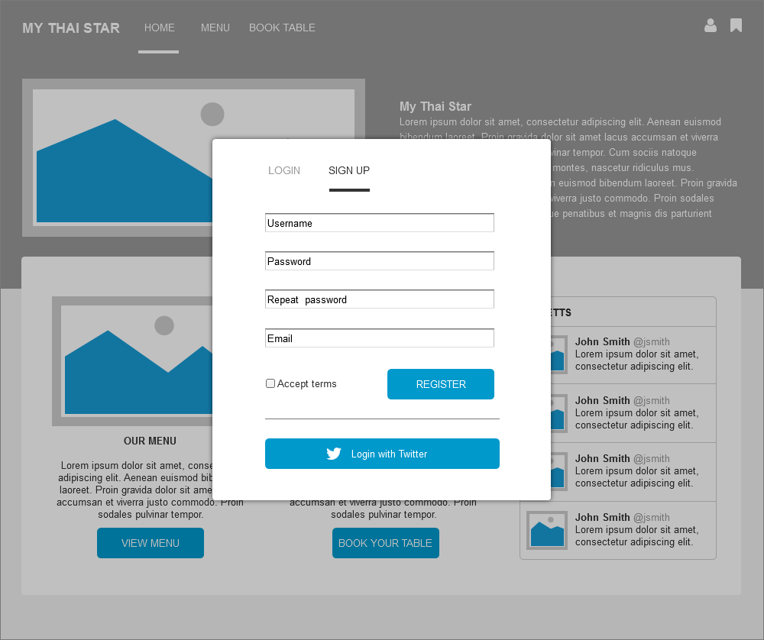
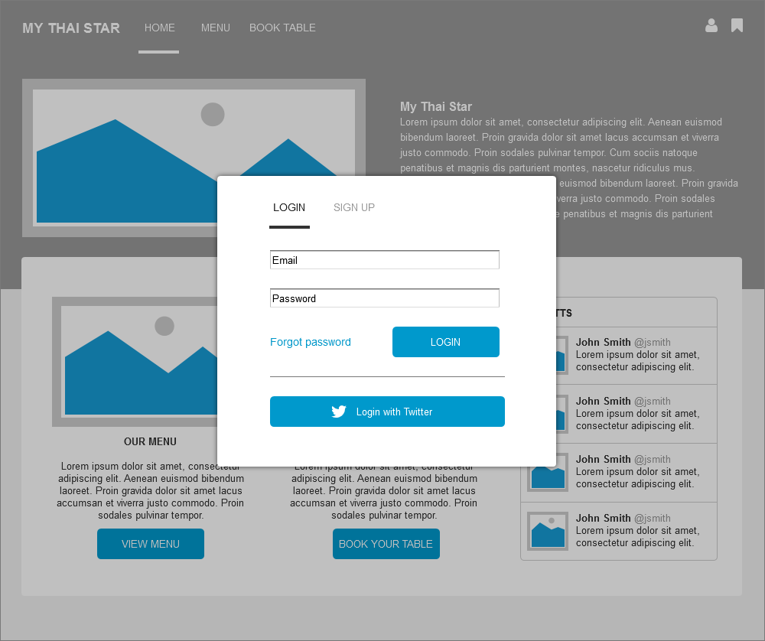
User profile: User profile
POP UP SIGN UP UI
POP UP LOGIN UI

Slide 21
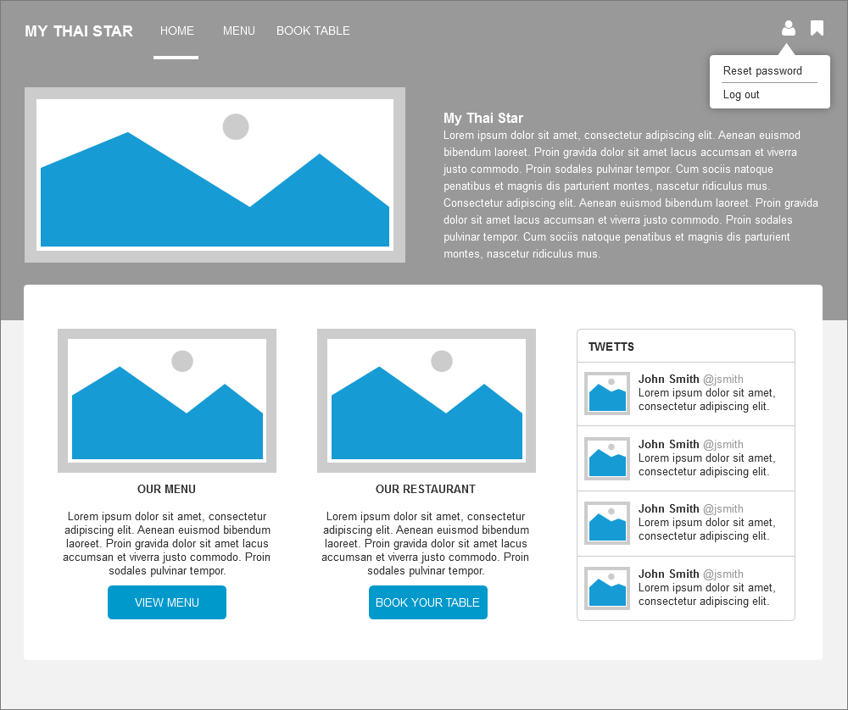
User profile: User profile
USER PROFILE
Option reset password and logout

Slide 22
Rate by Twitter
MY THAI STAR

Slide 23
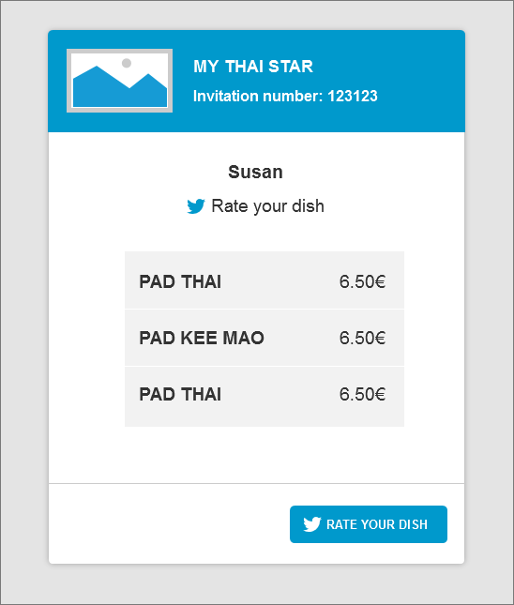
Rate by Twitter: Receive mail to rate your dish
EMAIL NEWSLETTER UI
Rate your dish

Slide 24
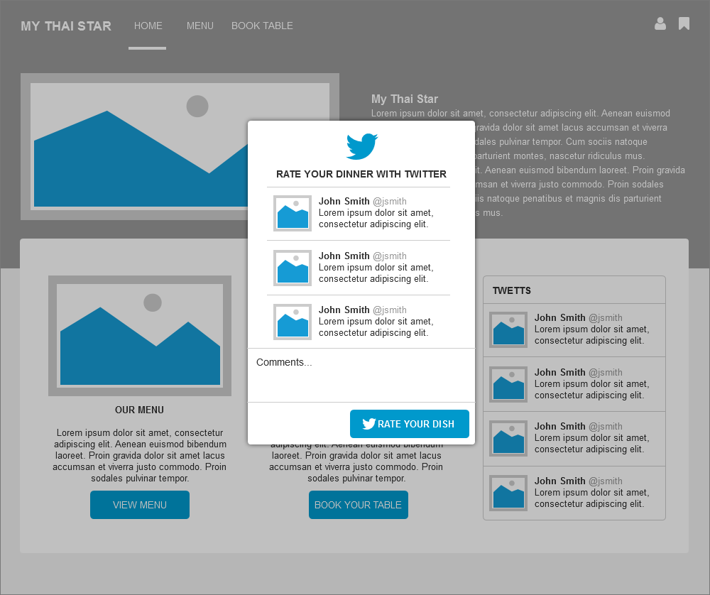
Rate by Twitter: Rate your dish
Twitter rate your dish

Slide 25
Waiter cockpit
MY THAI STAR

Slide 26
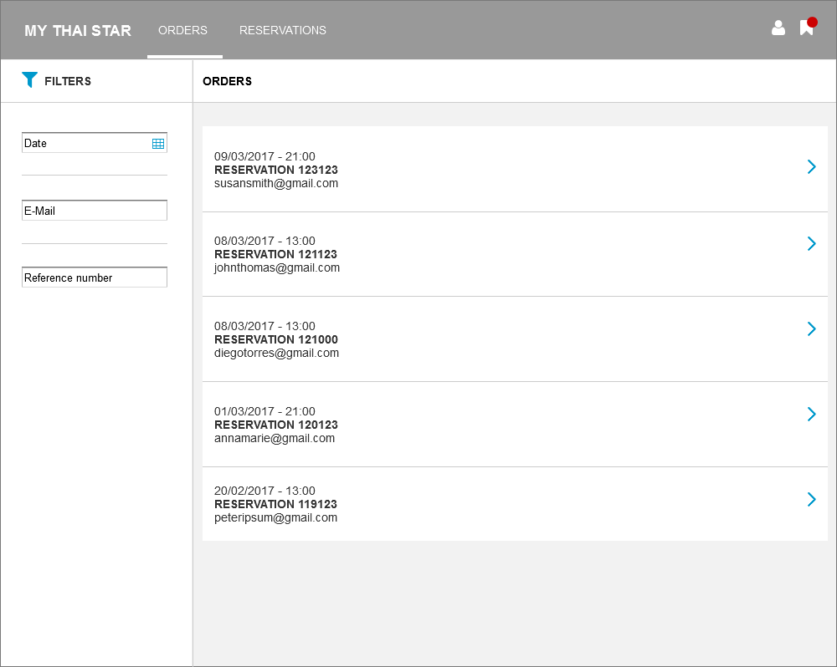
Waiter cockpit: See all orders / reservations
WAITER AREA UI
Orders list

Slide 27
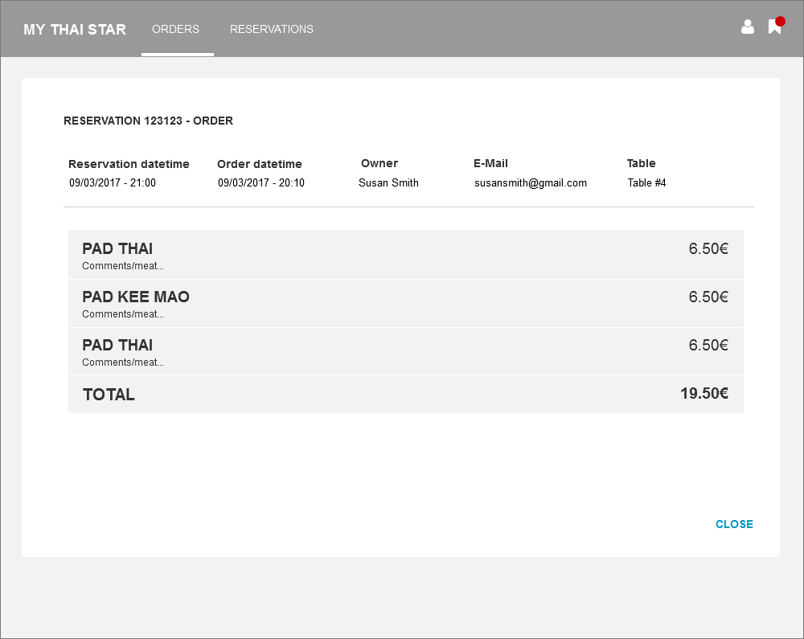
Waiter cockpit: See all orders / reservations
WAITER AREA UI
Orders detail

Slide 28
Waiter cockpit: See all orders / reservations
WAITER AREA UI
Reservations list

Slide 29
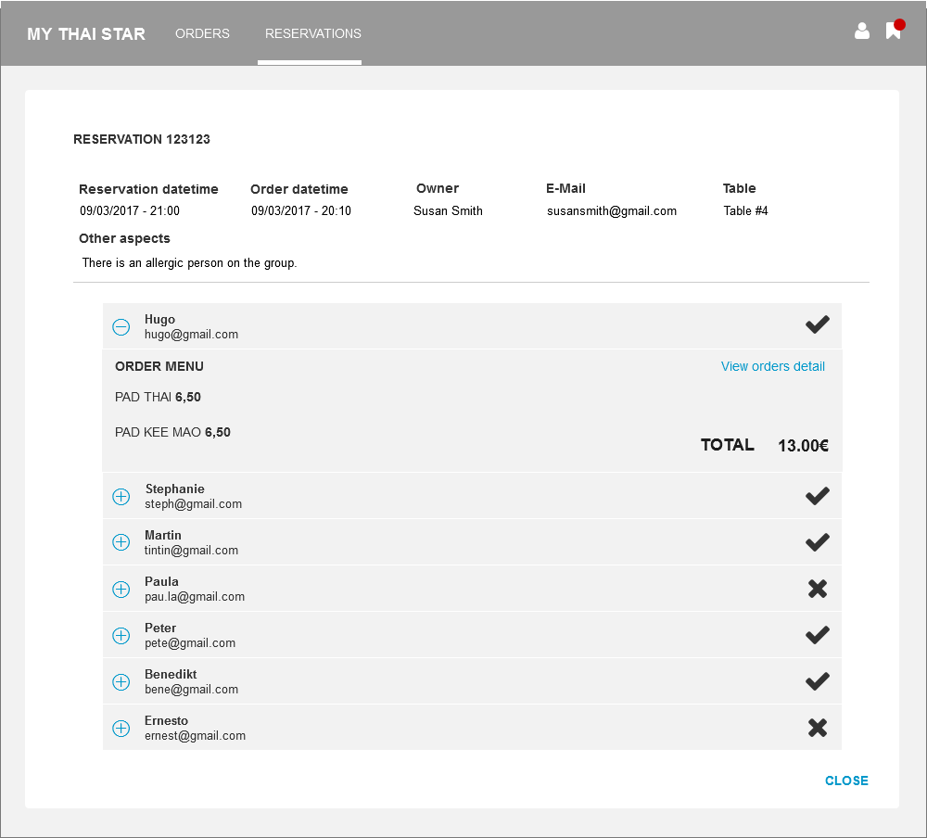
Waiter cockpit: See all orders / reservations
WAITER AREA UI
Reservation detail

